Slide 1


Connecting Presidential Collections
CPC aggregates metadata from digital collections by or about the U.S. presidents.
Sheila Blackford
Librarian
Amber Reichert
Web Developer

Slide 2
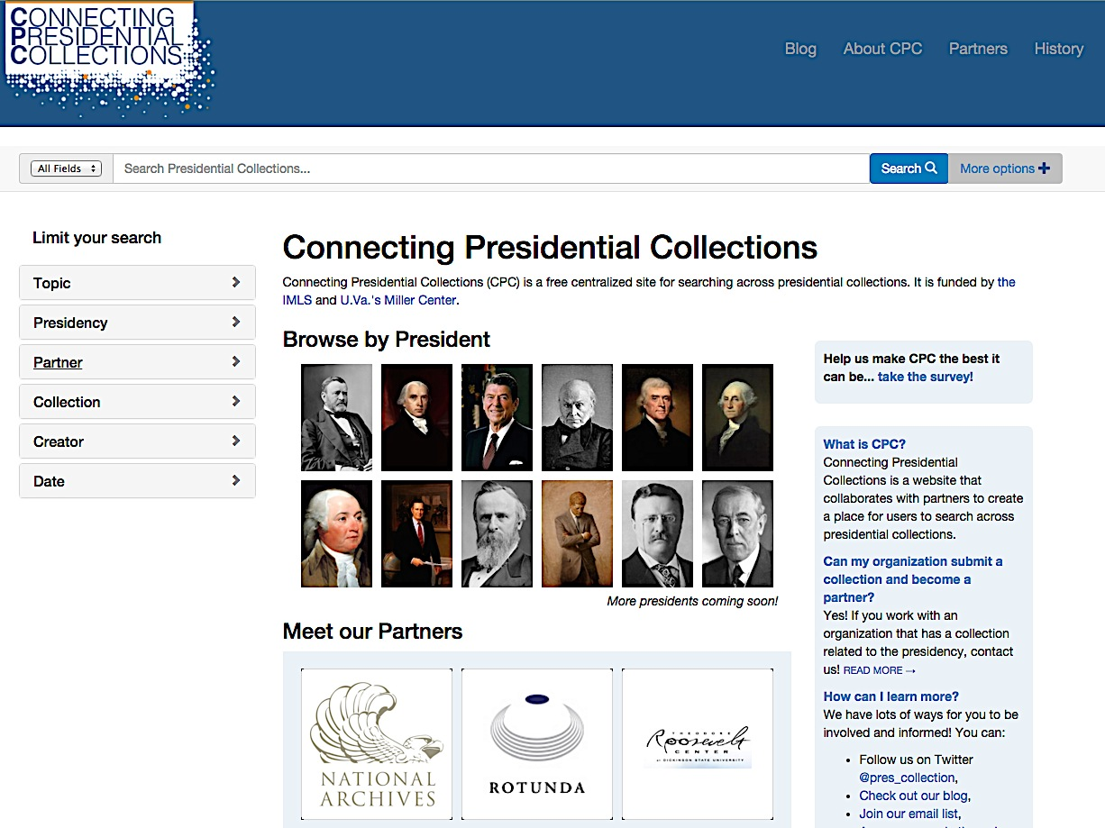

Slide 3


Funded by

Slide 4
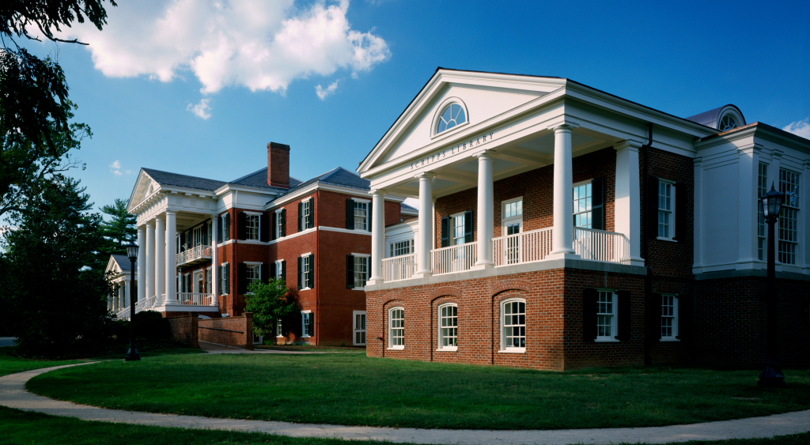
Miller Center University of Virginia

Slide 5
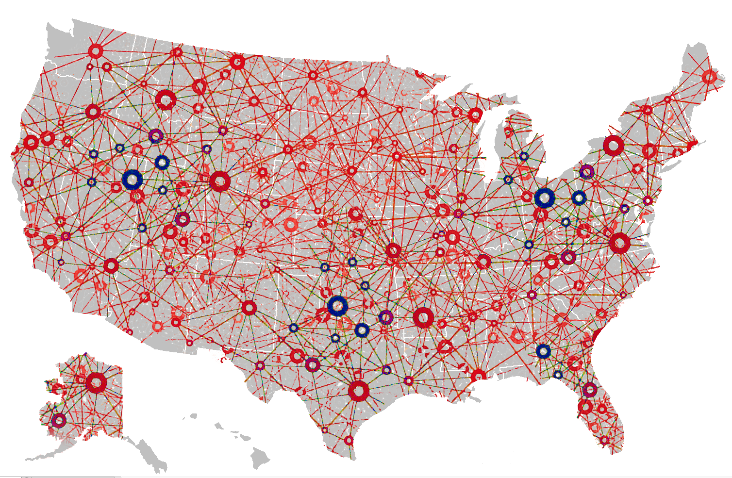
Map?

Slide 6
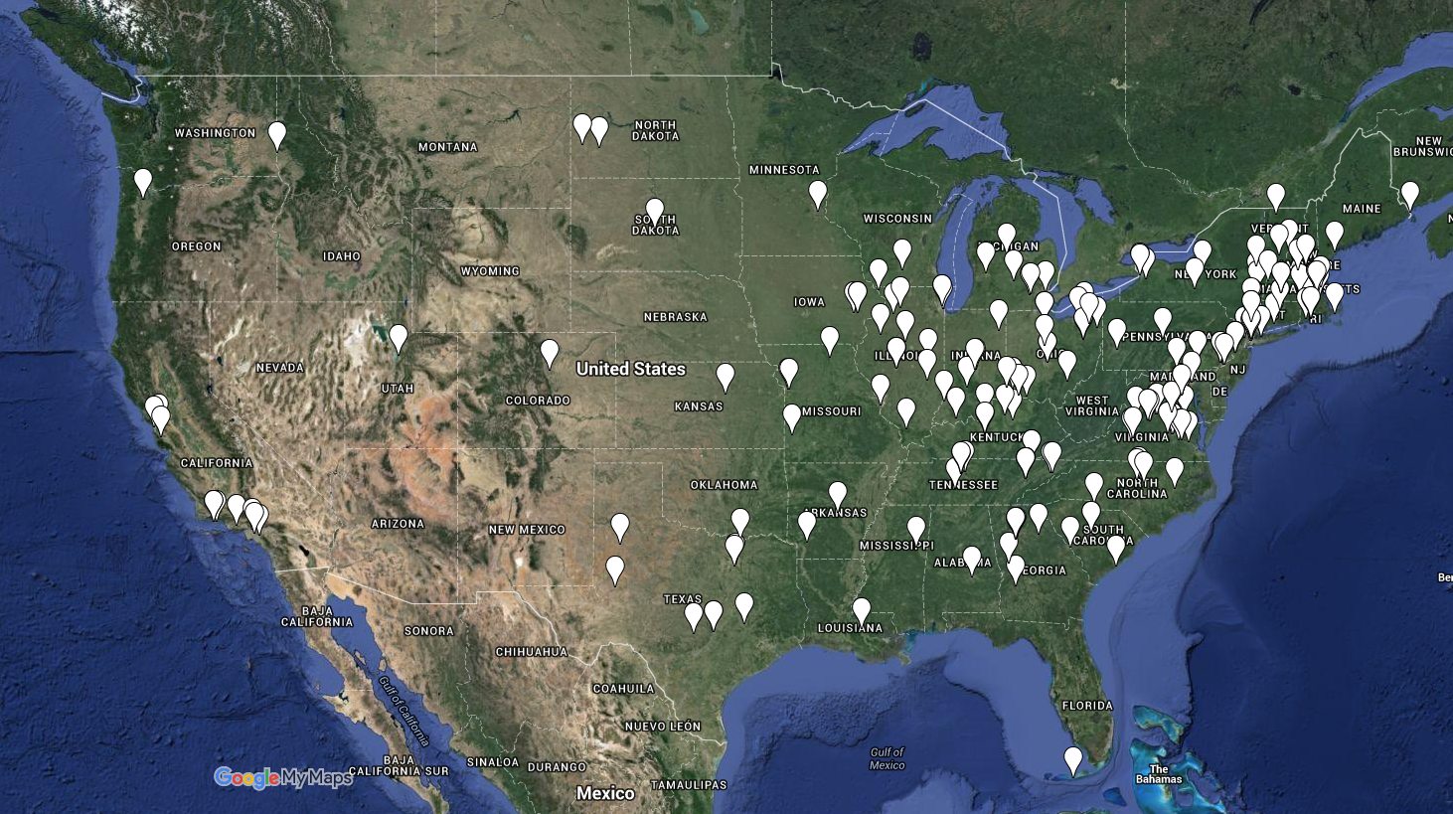
Map?

Slide 7


How does CPC work?

Slide 8
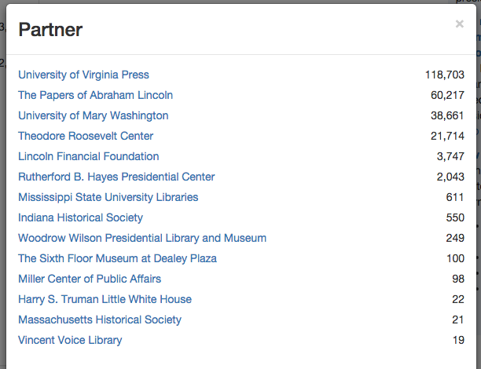

Slide 9
“You want people to digitize… but to what end? What’s in it for me?”
“We desperately need help with digitizing”
“Scanning is the least of it—you can’t just scan and that’s it, you have to have time to describe.”
“Our IT department doesn’t have the time to fix us”
“We need people willing to work for low wages”

Slide 10
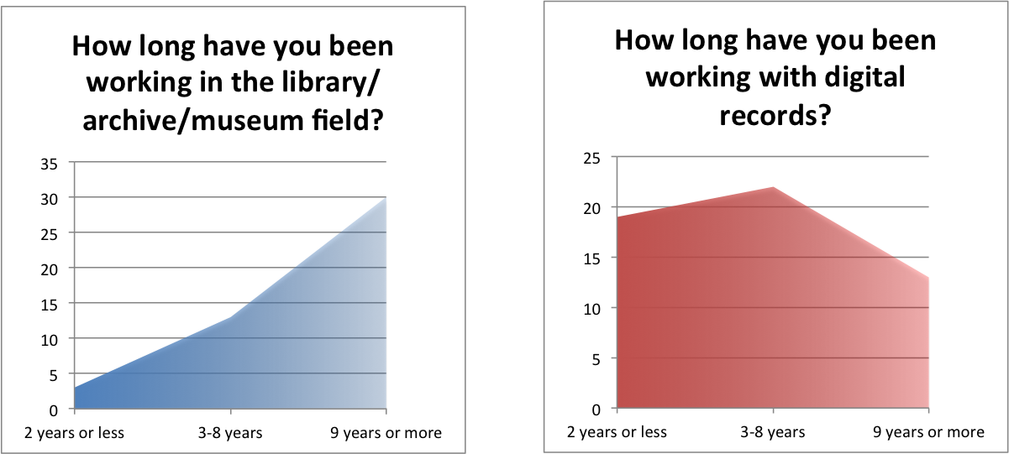

Slide 11
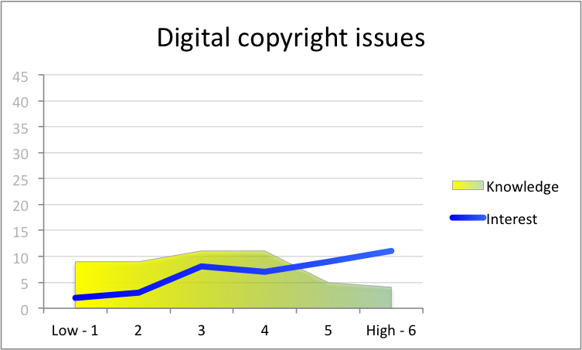
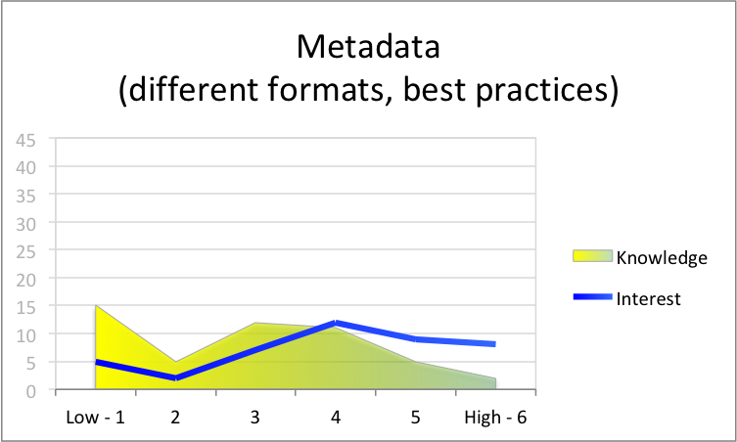
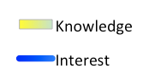
“Please rate your level of [knowledge of]/ [interest in learning about] the following areas…
Metadata
(different formats, best practices)
Digital Copyright Issues

Slide 12
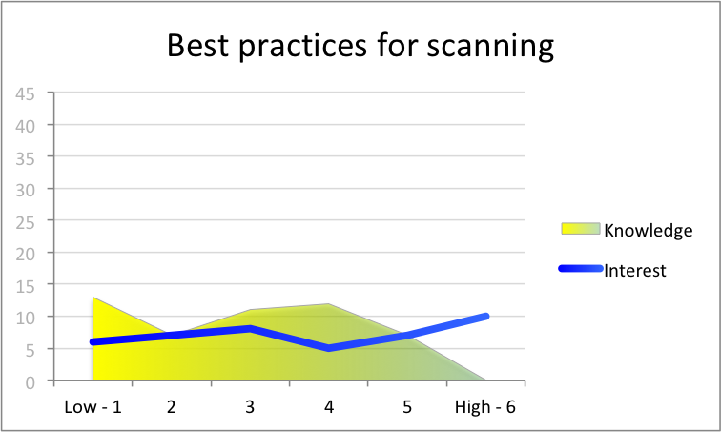
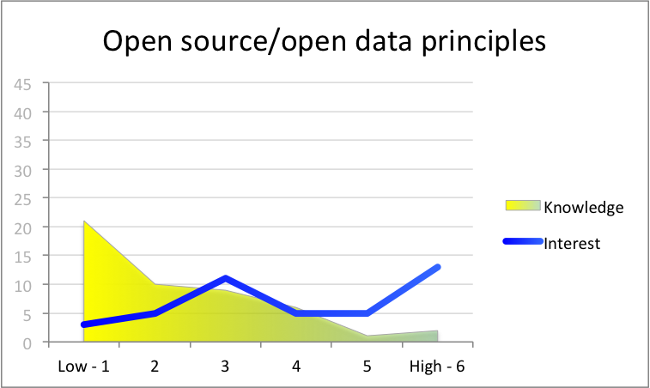
“Please rate your level of [knowledge of]/ [interest in learning about] the following areas…
Open Source/Open Data
Principles
Best Practices
for Scanning

Slide 13
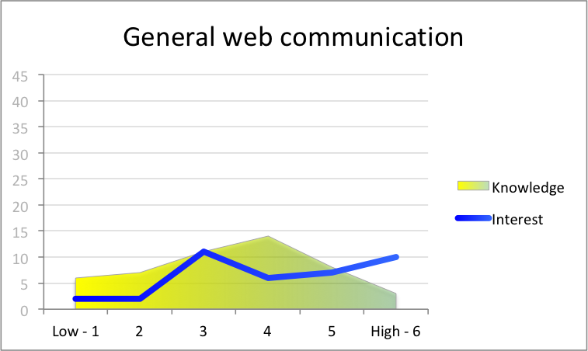
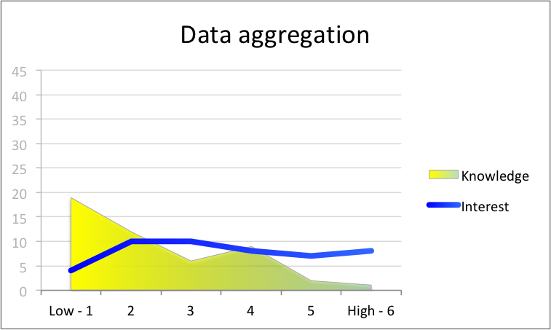
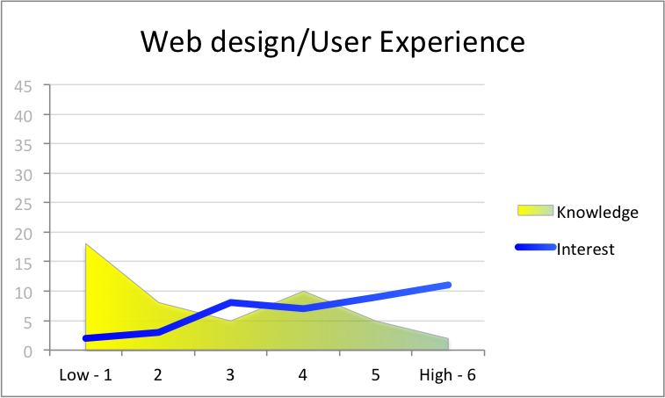
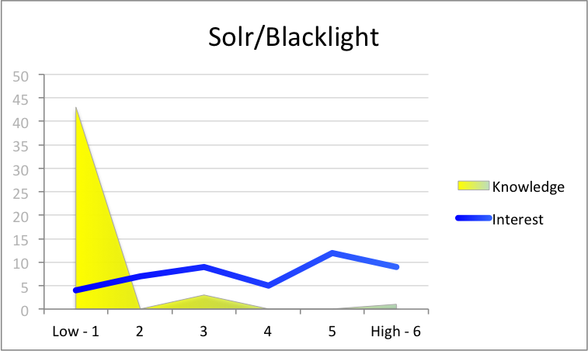

Slide 14
Key Specific Needs
$$$ (/people)
Access to technology (ex: better software)
Tech training (ex: how do I edit metadata records in our system?)

Slide 15
Takeaways
What does this mean for CPC?
What does this mean for our field?

Slide 16
What does this mean for CPC?
slow + steady
building critical mass
We’re in it for the long haul!

Slide 17
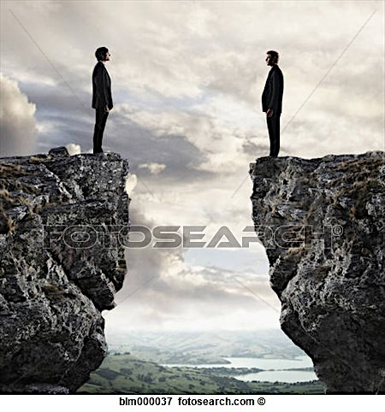
What does this mean for our field?

Slide 18
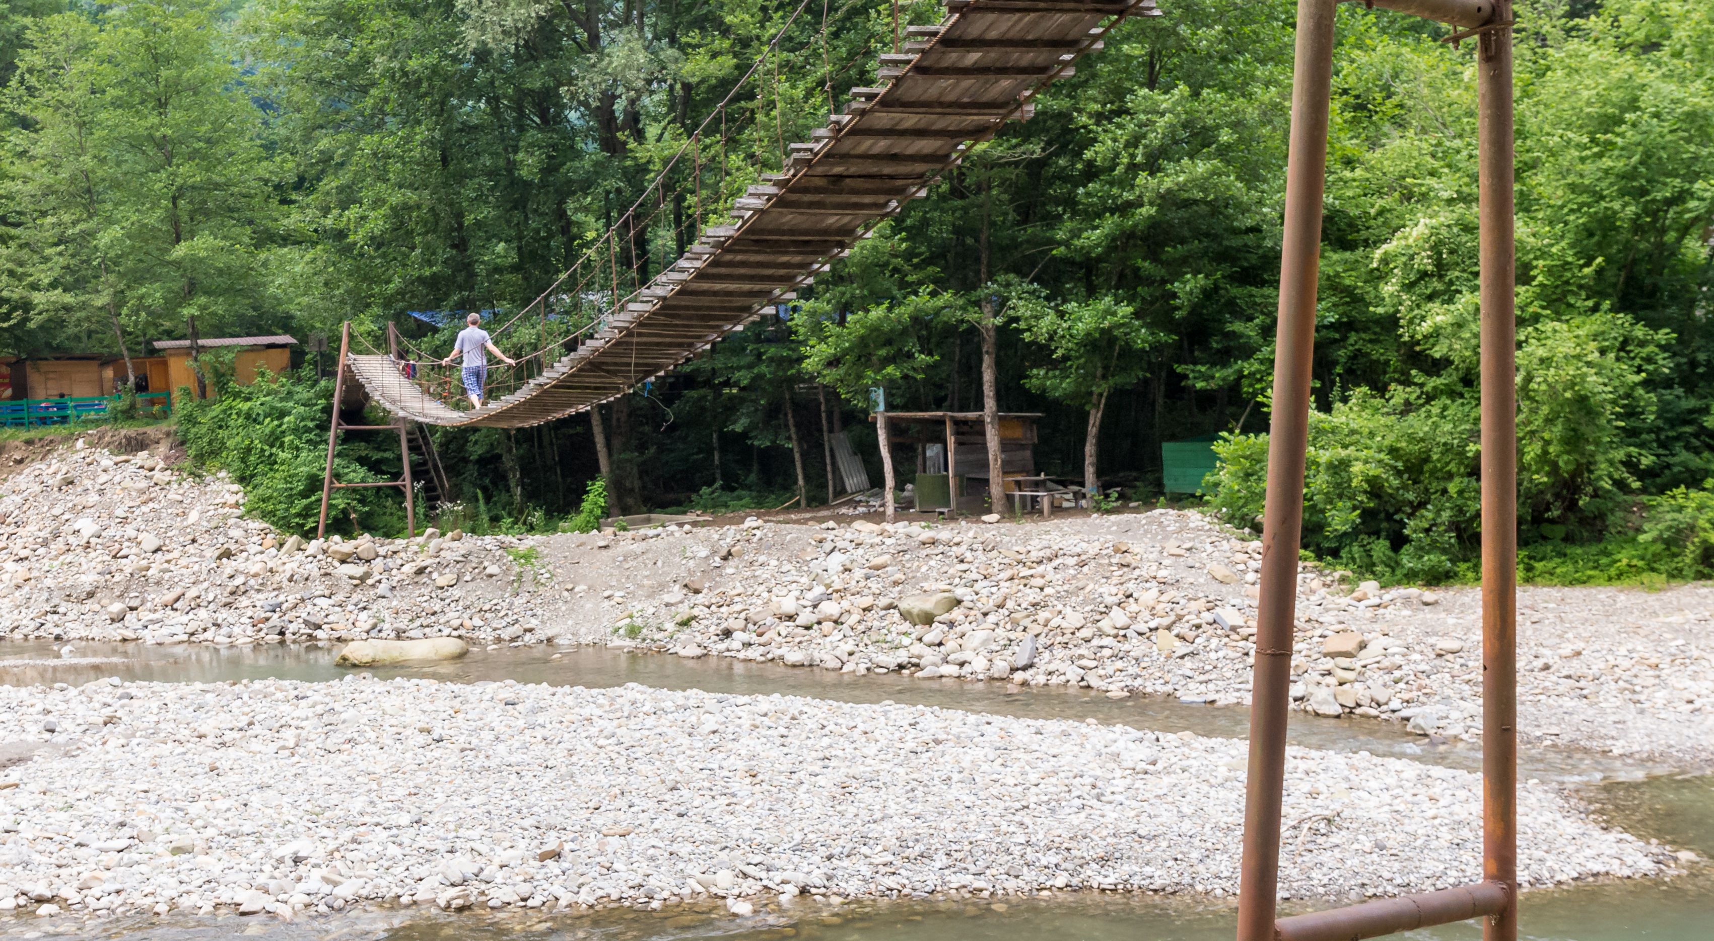

Slide 19
